Slide 1

Crisis Management
By Beth Binger
President & Founder of BCI Public Relations

Slide 2
Crisis Management
Overview
Plan for the Crisis
Investigation
Media Management

Slide 3
Overview

Slide 4
Why are schools unique?
Greater community connections
Primary audience is most digitally savvy
Primary audience may be least mature in understanding what to communicate to whom and when
Heightened emotional investment due to age and vulnerability of targeted population
Greater necessity for elected official involvement due to public policy ramifications

Slide 5
Crisis Response

Slide 6
Plan for the Crisis

Slide 7
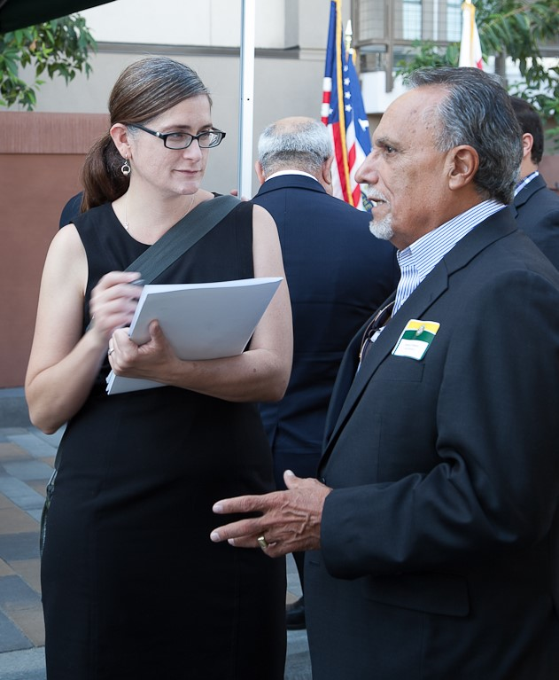
Make a Plan
Instruct all personnel not to make any statement to any outside party without approval from the district office.

Slide 8
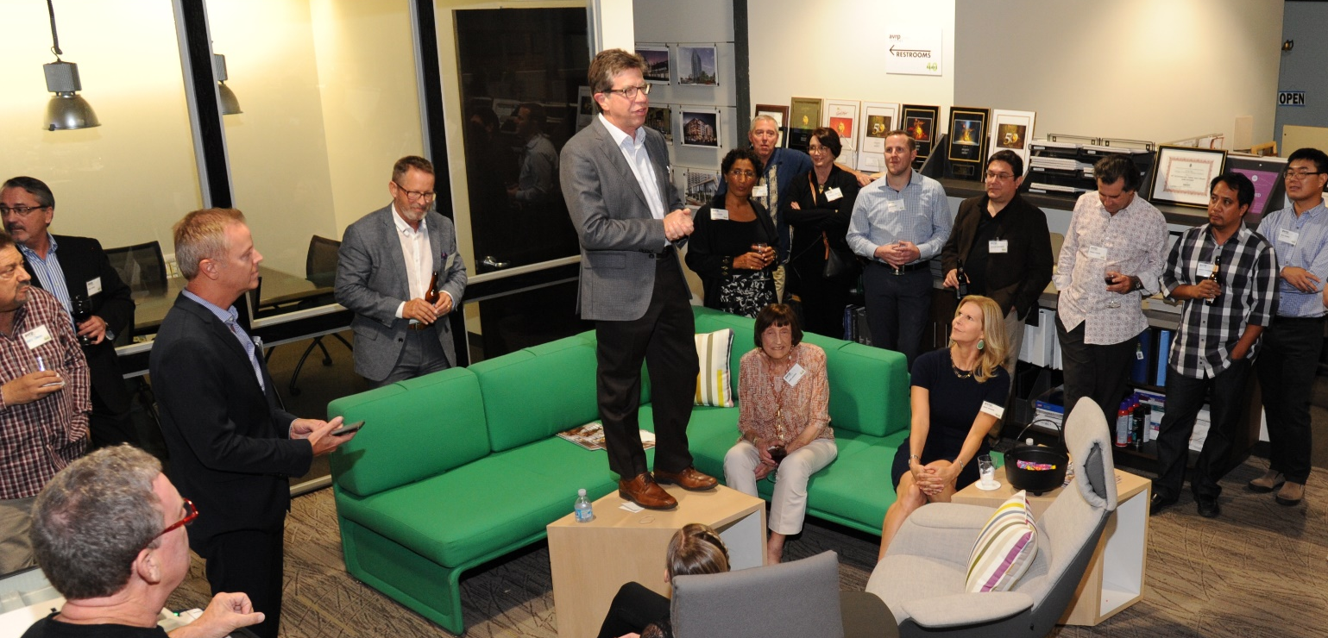
Establishing a Command Center
Decide the location of your crisis hub in advance.

Slide 9
Command Center Resources
Dedicated telephones
Webmaster access to school’s website to post updates
Webmaster access to school’s social media channels to post updates
Hard copies of emergency response and crisis communications plans
Site and building diagrams
Forms for documenting events as they unfold
Note taking tools: pens/pencils, paper, clipboards

Slide 10
Family Notifications
Decide in advance who will notify families in case of a crisis situation.
Keeping an updated list of emergency contacts of student and employee family members ensures quick communication in case of crisis. It is important for families to be aware of any emergencies before the media gets the news out.
Example:
Name | Relationship | Phone

Slide 11
Investigation

Slide 12
Control the Scene
After emergency units depart the scene, secure the area where the incident occurred and do not move any materials or other items that could have been involved in the incident.

Slide 13
Preserve Evidence
Protect all evidence so it may be documented during the investigation. It may be necessary to shut down the school and send students and employees home for the day.

Slide 14
Identify Witnesses
Once notification has been made, identify and isolate all witnesses to the event.
Do not allow the witnesses to discuss the event or exchange information. Keep them separated.

Slide 15
Interview Witnesses
Interview each witness one at a time. Take an audio statement of the facts as they remember the event.
Do not try to fill in the blanks or suggest what may have occurred.
It is best to take statements as soon as possible following the occurrence.
Be sure to inform witnesses that they will be interviewed by more than one investigator and they will be required to give additional statements.
The recorded statement they give will be made available to them for follow up interviews.
After the interview, the witness may be released for the day.

Slide 16
Video or Photograph the Scene
Take photos of everything in and around the incident site.
Additionally, record video.
Take accurate recording distance from known reference points. Every detail must be recorded and logged for use in preparing the written incident report.

Slide 17
Sketch the Scene
Make an accurate sketch of the incident scene, taking note of and documenting all measurements and reference points.

Slide 18
Complete Incident Report
Use your district’s incident report form.
In the absence of a district form, write up a detailed report noting who, what, when, where and how. Avoid speculation or drawing conclusions. Include any drawings, photographs, etc.
Submit to your district office within required timeframe (ie: 72 hours).

Slide 19
Complete Lessons Learned
Temporary and permanent actions should be developed, implemented, and monitored to prevent reoccurrence of the incident.

Slide 20
Media
Management

Slide 21
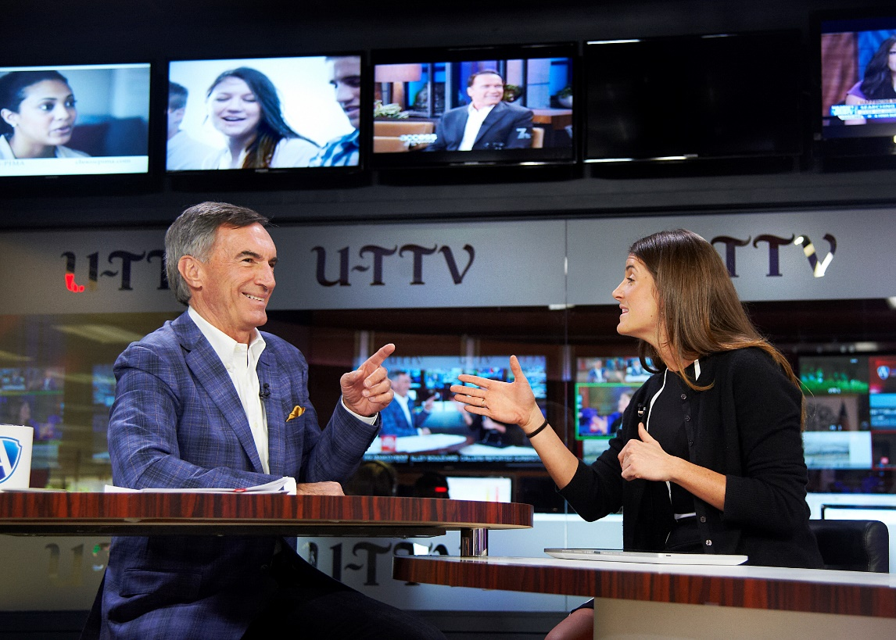
The public’s perception of how an incident was handled can either positively or negatively impact the school’s reputation, the district, the community, etc.

Slide 22
Potential Audiences
Students
Parents, families, and caregivers
Survivors impacted by the incident and their families
News media
Community members, especially neighbors living near the school
School management, administrators, staff, teachers
Government elected officials, regulators, and other authorities

Slide 23
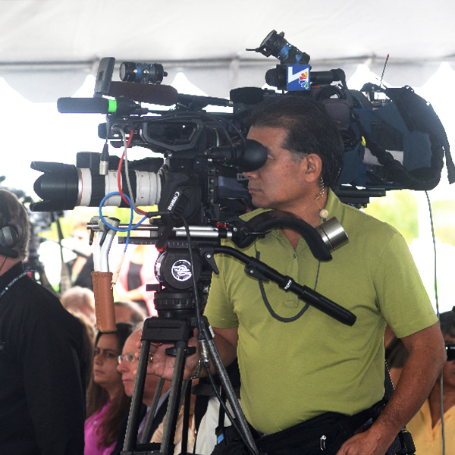
Press Conference Process
Make a statement; have it in writing
Questions submitted in writing
Answer questions at second press conference; have it in writing, accept subsequent questions
Partner with law enforcement
Critical to have statement in writing due to number of audiences.
You will be judged by consistency of info more than accuracy.

Slide 24
Did You Know?
The human mind processes words at a rate of approximately 500 a minute but we speak at about 150 words a minute.
It has been estimated by communications researcher Professor Albert Mehrabian* that words account for only 7% of a speaker’s effect on an audience. A massive 55% of the speaker’s impact comes from the visual, i.e., how he/she looks, facial expression, gestures, body language and posture, etc., while 38% of his/her impact comes from voice: does he sound trustworthy, is his voice varied and interesting?
      *Professor Emeritus of Psychology, UCLA

Slide 25
Press Conference Organization
Solicit handwritten media questions at press conferences. Have an assistant present to collect questions and watch the mood of the group for the spokesperson. Why?
  Shows school’s proactive nature and willingness to provide the media what they need and want.
  Let’s you know what is on the media’s mind.
  Helpful to know what is being asked and said by the media.

Slide 26
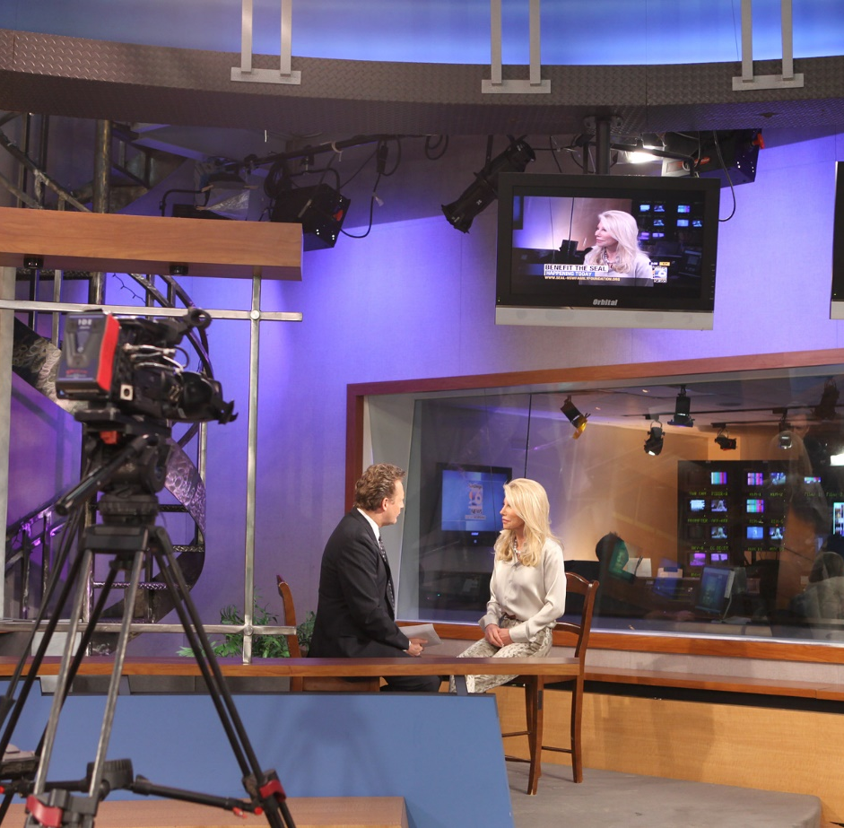
Public Statement: Where to start?
Who, what, where, when how
Inverted pyramid: Most important info at the top.

Slide 27
Sample Statement: 1st Press Conference
“My name is __________, and I am the (position) at this school. An incident has just occurred, and I don’t have any facts to give at this time. Please give me _________ minutes to collect any information I can. Until that time, please stay within the safety area. Thank you.”
*Do not take any questions at this time. If badgered, simply state that you need to get back to the site and will return at the stated time.
This statement does three things:
Buys you time to collect data
Shows media you are proactive rather than reactive
Shows you will not speculate and need time to gather facts

Slide 28
Sample Statement: 2nd Press Conference
“Due to the rush of the emergency, and coordination of emergency services, I have been unable to obtain verifiable information. I’m sorry that I don’t have any information at this time, but anything I say would be speculation, which would be inappropriate. I will be back in ___________ minutes to give you an update.”
Key Points:
Always come back when you say you will be there, even if you have nothing to say
Continue to stay proactive with media
Keep media as current as possible on status of your situation until it is no longer a news story

Slide 29
Sample Statement: Key Messaging
“Good ___________. My name is ___________ and I am the (position) for (school) . This is what we can confirm at the present time: At approximately (time) we experienced a (brief description). At this point we cannot verify the extent of the damage or injuries other than to say that it has involved (specific facilities) and (number) people. We will not disclose the names and conditions of the persons involved until their next of kin have been notified. Emergency assistance from (police, fire, etc.) responded to this incident. We will be providing additional information as it is confirmed.”
If you are asked additional questions, sample follow up statement:
“That is all I can confirm at the present time. I am sure you understand we are all very busy trying to deal with this situation and ask for your patience. As soon as we have more information that has been confirmed, it will be disclosed. Anything involving our employees or students will be disclosed to their families and loved ones first. Thank you very much.”

Slide 30
Tips & Techniques for Spokesperson
Have a clear agenda, and make sure your brain is engaged before you open your mouth.
Be honest. You don’t have to tell everything that you know, but everything you do tell must be the truth.
Show humanity. In a crisis situation, you must remember to show compassion.
Don’t admit liability.
Don’t be defensive – it implies guilt.
Be aware of your body language. Your face and your body telegraph your emotions.
Maintain eye contact. Be sure your facial expression remains pleasant no matter how provocative or dumb the questions.

Slide 31
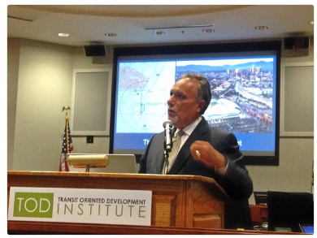
Techniques for Non-Verbal Preparation
60% of our communication is non-verbal
Stance
Posture
Facial Expressions
Hand Gestures
Eye Contact

Slide 32
Techniques for Non-Verbal Preparation
Be Aggressive
  Engage audience intellectually and through body language. Make eye contact. Concentrate on particular individuals.
Control Quality of Voice Through Physical Techniques
  Breathing – Very important! Utilize breathing techniques to control voice quality and seem relaxed
  Movement – Subtle, deliberate
Establish Non-Verbal Cues Within Presentation
  Highlight areas of speech to re-affirm non-verbal message (i.e. pauses, change in posture, stance)
  Identify areas with troubled body language

Slide 33
Media Myths
The reporter is my friend. A reporter has a job to do – to report. If the reporter was favorable in the past, that doesn’t make him/her a friend. The job comes first.
Treat all media as if they work for “60 Minutes”. If you do that, you will be confrontational, and your attitude will have an impact on the story. Be courteous and professional.
We can talk off the record. Fine, but if you say it, you can expect it to be in print or broadcast. “Off the record” should be stricken from your vocabulary.
I have to give another (better) answer. If a reporter is manipulative he might come back to a sensitive topic several times. You should not feel you need to come up with a better answer. Stick with the original one.
When boxed in, say “no comment.” That’s like a defendant pleading the Fifth Amendment, and it’s a red flag. Reporters will think you are hiding something. Instead, try “It’s not appropriate for me to discuss that at this time,” or “There is nothing new I can add.”

Slide 34
Media Myths
During an interview it’s my job to fill the silence. Not at all. Some reporters create the silence hoping that you will feel obliged to speak up and break the silence, and the more you talk the better the chance is that you will say something you didn’t want to say in the first place.
Answer every question. Certainly not required. If you do not like a question, redirect it with “This real question to ask is…” and “That’s not the issue. The real issue is....”
If a reporter comes up with a fact, it must be right. If you don’t think it is correct, don’t accept it. Reporters often have little background on the subject they are covering and thus can’t possibly know all the facts.
Once the notebook is closed the interview is over. It’s never over until the reporter is out of the building, out of hearing range, out of sight.

Slide 35
Press Contacts: SD Print Media
Publication | Contact | Title | Email
San Diego Business Journal | Nels Jensen | Managing Editor | njensen@sdbj.com
The Daily Transcript | Doug Sherwin | Managing Editor | Doug_sherwin@sdtranscript.com
UT San Diego | Diana McCabe | Business Editor | diana.mccabe@utsandiego.com
San Diego Metro | Manny Cruz | Editor | manny@sandiegometro.com
San Diego Magazine | Erin Chambers Smith | Senior Editor | erin@sandiegomagazine.com
Voice of San Diego | Scott Lewis | Editor | scott.lewis@voiceofsandiego.org
Times of San Diego | Chris Jennewein | Editor & Publisher | chrisj@timesofsandiego.com
SD Community Newspaper Grp. | Anne Terhune | Editor in Chief | mail@sdnews.com
Hispanos Unidos | Jaime A. Castañeda |  | jaime@hispanosnews.com

Slide 36
Press Contacts: SD TV Media
Station | Name | Email
NBC | Sage Waetjen | sage.waetjen@nbcuni.com
KGTV | News Desk | 10news@kgtv.com
Fox 5 | News Desk | news@fox5sandiego.com
KUSI | News Desk | news@kusi.com
KFMB | News Desk | desk@kfmb.com
Televisa | Marinee Zavala | marinee.zavala@gmail.com
Entravision | Edi Carlos Gonzales | cgonzales@entravision.com

Slide 37
Crisis Management
Thank You

