Slide 1
CHECKLIST OF ACTIONS
Individual and Family or Community

Slide 2
Individual / Family
I/we can make these changes in my life / my family’s life:
1-Increase efficiency: Turn lights off or don’t turn on if there is natural lighting. Replace inefficient light bulbs with LED or other efficient lighting. Consider insulation, more efficient windows or other home improvements. Conserve water.
2- Eat wisely: Buy organic and locally grown foods. Grow some of your own food. Home cook more meals. Eat low on the food chain – at least one meat-free meal a day – since 18% of greenhouse gas emissions come from meat and dairy production. Food writer Michael Pollan sums it up best: “Eat food; Not too much, mostly plants.” Use less chemical fertilizers or sprays.
3- Travel wisely: ride your bike to local destinations, take transit where possible, work from home, carpool, try a staycation, fly less. Buy an electric or hybrid car.

Slide 3
Vera House Community Garden of the St. Didacus Creation Care Team

Slide 4
4- Reduce waste: Use washable dishes. Use a home filter instead of bottled water. Reduce food waste. Choose products with less packaging. Recycle paper, plastics, bottles and aluminum cans. Buy only what I need: food, clothing, furniture, technology etc. Rid of Styrofoam, use paper.
5. Conserve water by taking shorter showers, planting a “desert” garden, or using artificial turf.
6. Go renewable: Consider rooftop solar, solar hot water, or other renewable choices.
7- Talk to friends, colleagues and family about what you are doing to be more sustainable.

Slide 5
Low water use lawn in San Diego.

Slide 6
SCHOOL, PARISH or COMMUNITY:
We can join with others in our school, parish or community to advocate for or make these changes:
1-Educate congregation and community members – which areas do you want to go deeper into? Refer folks to an appropriate speaker or guest preacher. Teach school students of the need to conserve energy and natural resources.
2- Organize prayer as a sacred moment to reflect on the oneness of creation; water, earth and sun. Form an ecological spirituality: we are one family with a common home.
3- Increase efficiency: Inventory energy use and explore opportunities for efficiency, such as efficient lighting, insulation, windows, and low flush toilets.

Slide 7
Creation Care Team of St. Didacus.

Slide 8
4- Encourage renewable: On rooftop solar for your facility. Repair, Reuse or Recycle (the 3 Rs).
5- Encourage low-carbon, sugar and salt snacks and meals, sharing garden products, especially with those in need.
6- Organize car pools for community meetings and activities and include transit information in event directions. Organize a study group on “Laudato Si”.
7. Meet or correspond with people from other schools, parishes or communities to share activities.
8- Join with other community groups working on climate change and sustainability. Talk to authorities.
“Live simply, that others may simply live”

Slide 9
Solar panel installation in St. Francis parking lot , Vista, Ca.

Slide 10
Eco Friendly – Sustainable practices Environmental Stewardship Presentation PASTORAL CENTER SAN DIEGO DIOCESE.
- Go Paperless – Use apps, QR codes, and websites to save paper. Also, make sure to put your agenda online!
No more plastic – Don’t hand out plastic water bottles and individually wrapped items to participants, instead place
glasses and water pitchers in the meeting space. Don’t order bottled waters at your event.

Slide 12
Go Local – Serve local food and beverages to decrease your carbon footprint.
Separate Trash and Recyclables – Place recycling bins next to trash cans for easily depositing the odd plastic bottle that slips into the meeting.
Reduce -Incorporate hors d'oeuvres that don't require utensils to eat.
Demonstrate good practices - Only use ecofriendly plates and utensils that are made from plant starch that breakdown quickly in landfills. Use napkins made from recycled content.

Slide 13
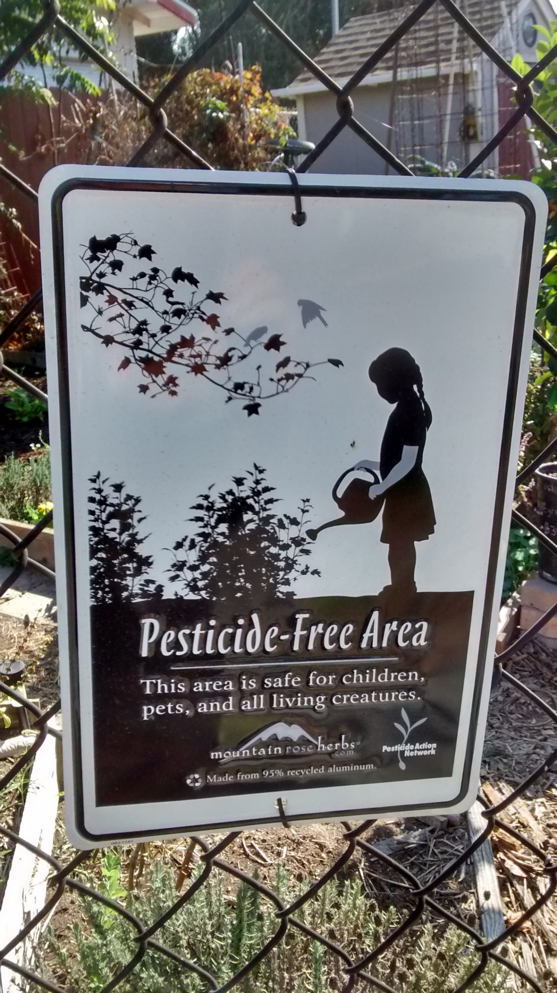

Slide 14
Walk the Talk Dress event staffers in organic cotton t-shirts
Save Paper and ink -Eliminate printed handouts. Ask folks to submit their email addresses on the back of their nametags to receive notes and presentations from the meeting
Partner with Global Disposable for a green event planning.
Get help from Vendors - Make them aware that you are looking for opportunities to incorporate sustainable practices and ask them to do the same.
Low hanging fruit -Use biodegradable reusable PVC name tag holders and name tags made from recycled paper

Slide 16
Show results - Display current data of energy produced by the solar system
TO ORDER MATERIALS OF GET PRICES ON ECO-FRIENDLY MATERIALS email ajewel@appinc.com Prices range from 2 to 17 cents for objects bought in containers or bulk.
http://www.pcnametag.com/product/1065/name-tag-holders-green-clip
Submitted by John Ohle Our Mother of Confidence Parish 8/28/2017

Slide 17
THE EIGHT FACES OF “SUSTAINABILITY”
NO POVERTY
ZERO HUNGER
GOOD HEALTH - WELL BEING
QUALITY EDUCATION
GENDER EQUALITY
CLEAN WATER SANITATION
RENEWABLE ENERGY
GOOD JOBS - ECONOMIC GROWTH

