Slide 1
A 45 Year History of Struggle to Protect Creation
We must resist those who would endanger the undocumented, refugees, Muslims, our health care, the nutrition of children and the environment and make these issues the foundation for common efforts rather than of division.
(Words adapted from a speech by Bishop Robert McElroy to community organizers in Modesto, Ca. in Feb. 2017).

Slide 2
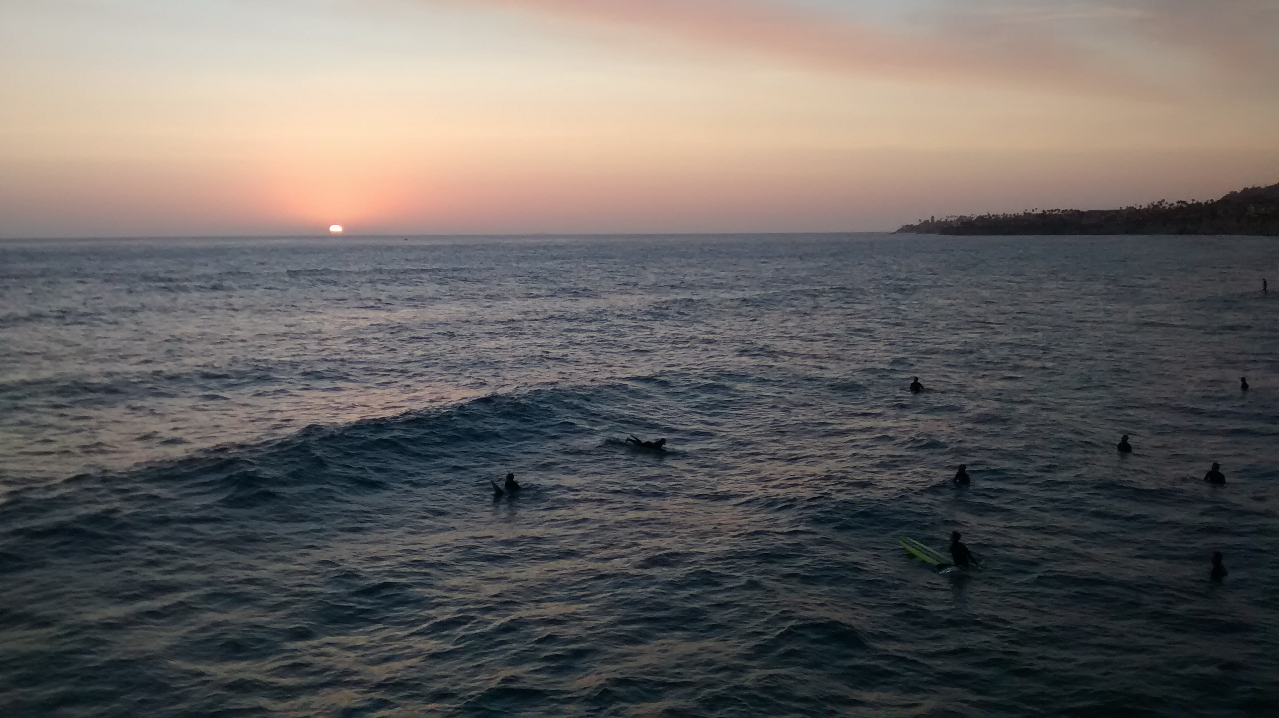
In February 1972 the United States abandoned nuclear testing grounds at Amchitka Island, Alaska.

Slide 3
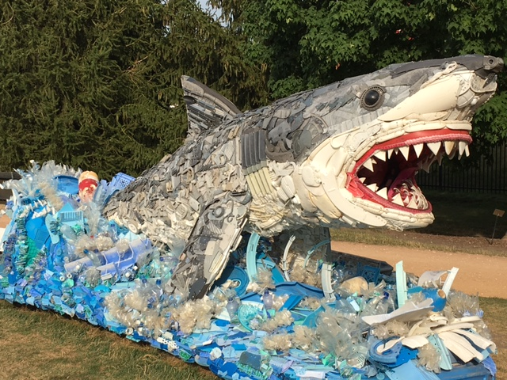
In October 1982the International Whaling Commission adopted a whaling moratorium.
Photo from
The Reiman
Gardens on
the Iowa
State Univ.
campus,
Ames, Ia.

Slide 4
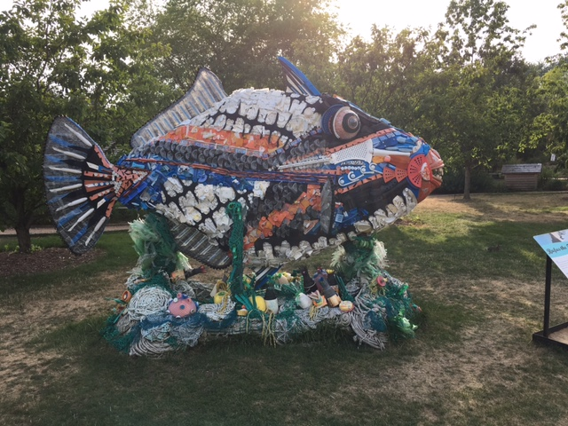
In DECEMBER 1989 a UN moratorium on high seas large-scale driftnets is passed, responding to public outrage at indiscriminate fishing practices exposed by Greenpeace.
In July 1991 a worldwide ban went into force.
Photo from
The Reiman
Gardens, at
Iowa State
Univ. Campus
Ames, Ia.

Slide 5
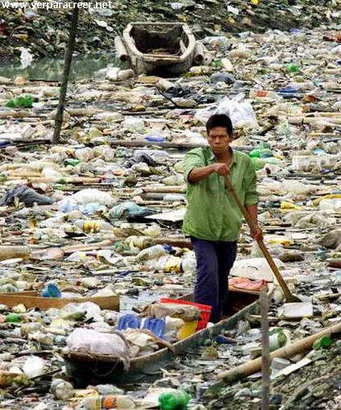
In NOVEMBER 1993 after repeated actions against ocean dumping for more than a decade, the London Dumping Convention permanently banned the dumping at sea of radioactive and industrial waste worldwide.

Slide 6
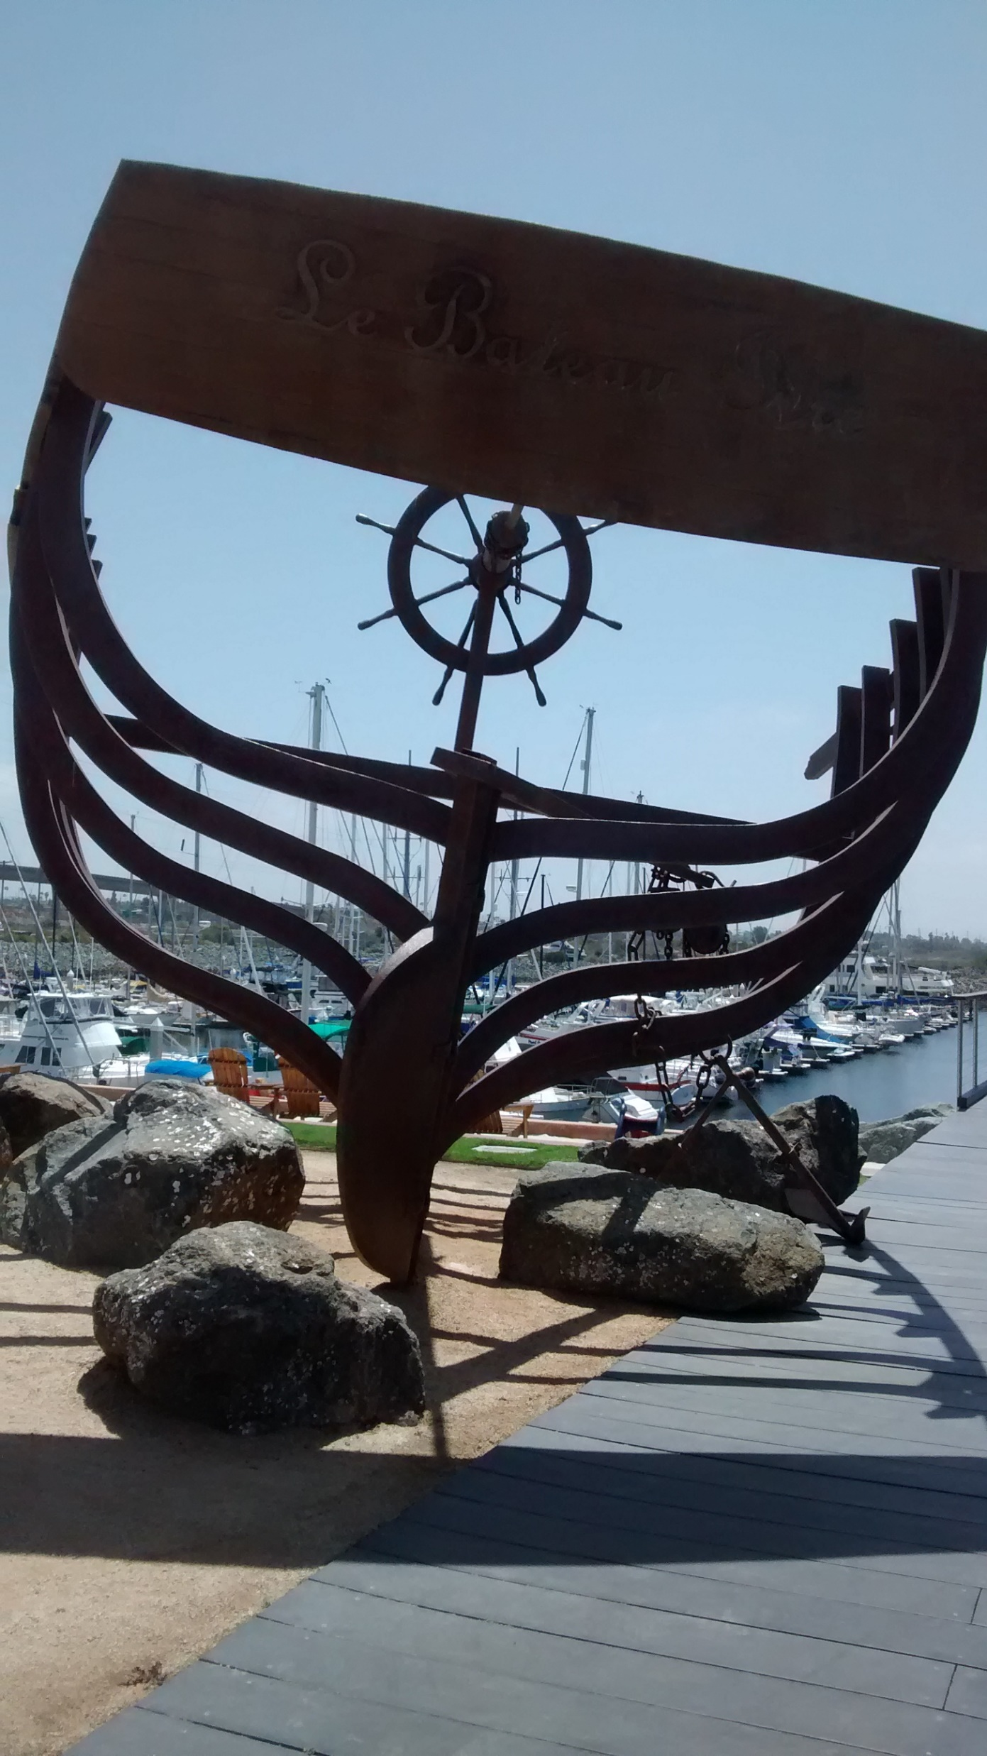
In DECEMBER 1994 The Antarctic whale sanctuary is approved by the International Whaling Commission.
Skeleton
of a
sea faring
vessel, at
The Marina
National City,
Ca.

Slide 7
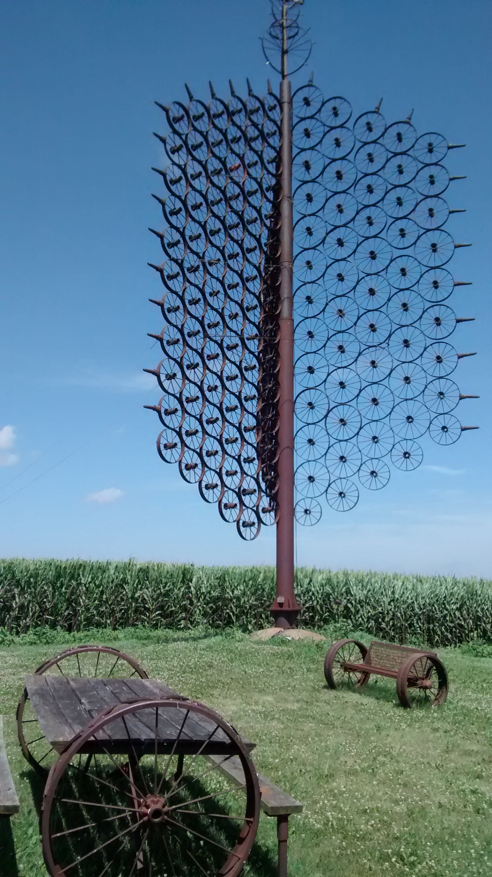
In JUNE 1996 the Comprehensive Nuclear Ban Treaty is adopted by the United Nations.
Rural area
park of
defunct
iron wagon
wagon rims.
Grinell, Ia.

Slide 8
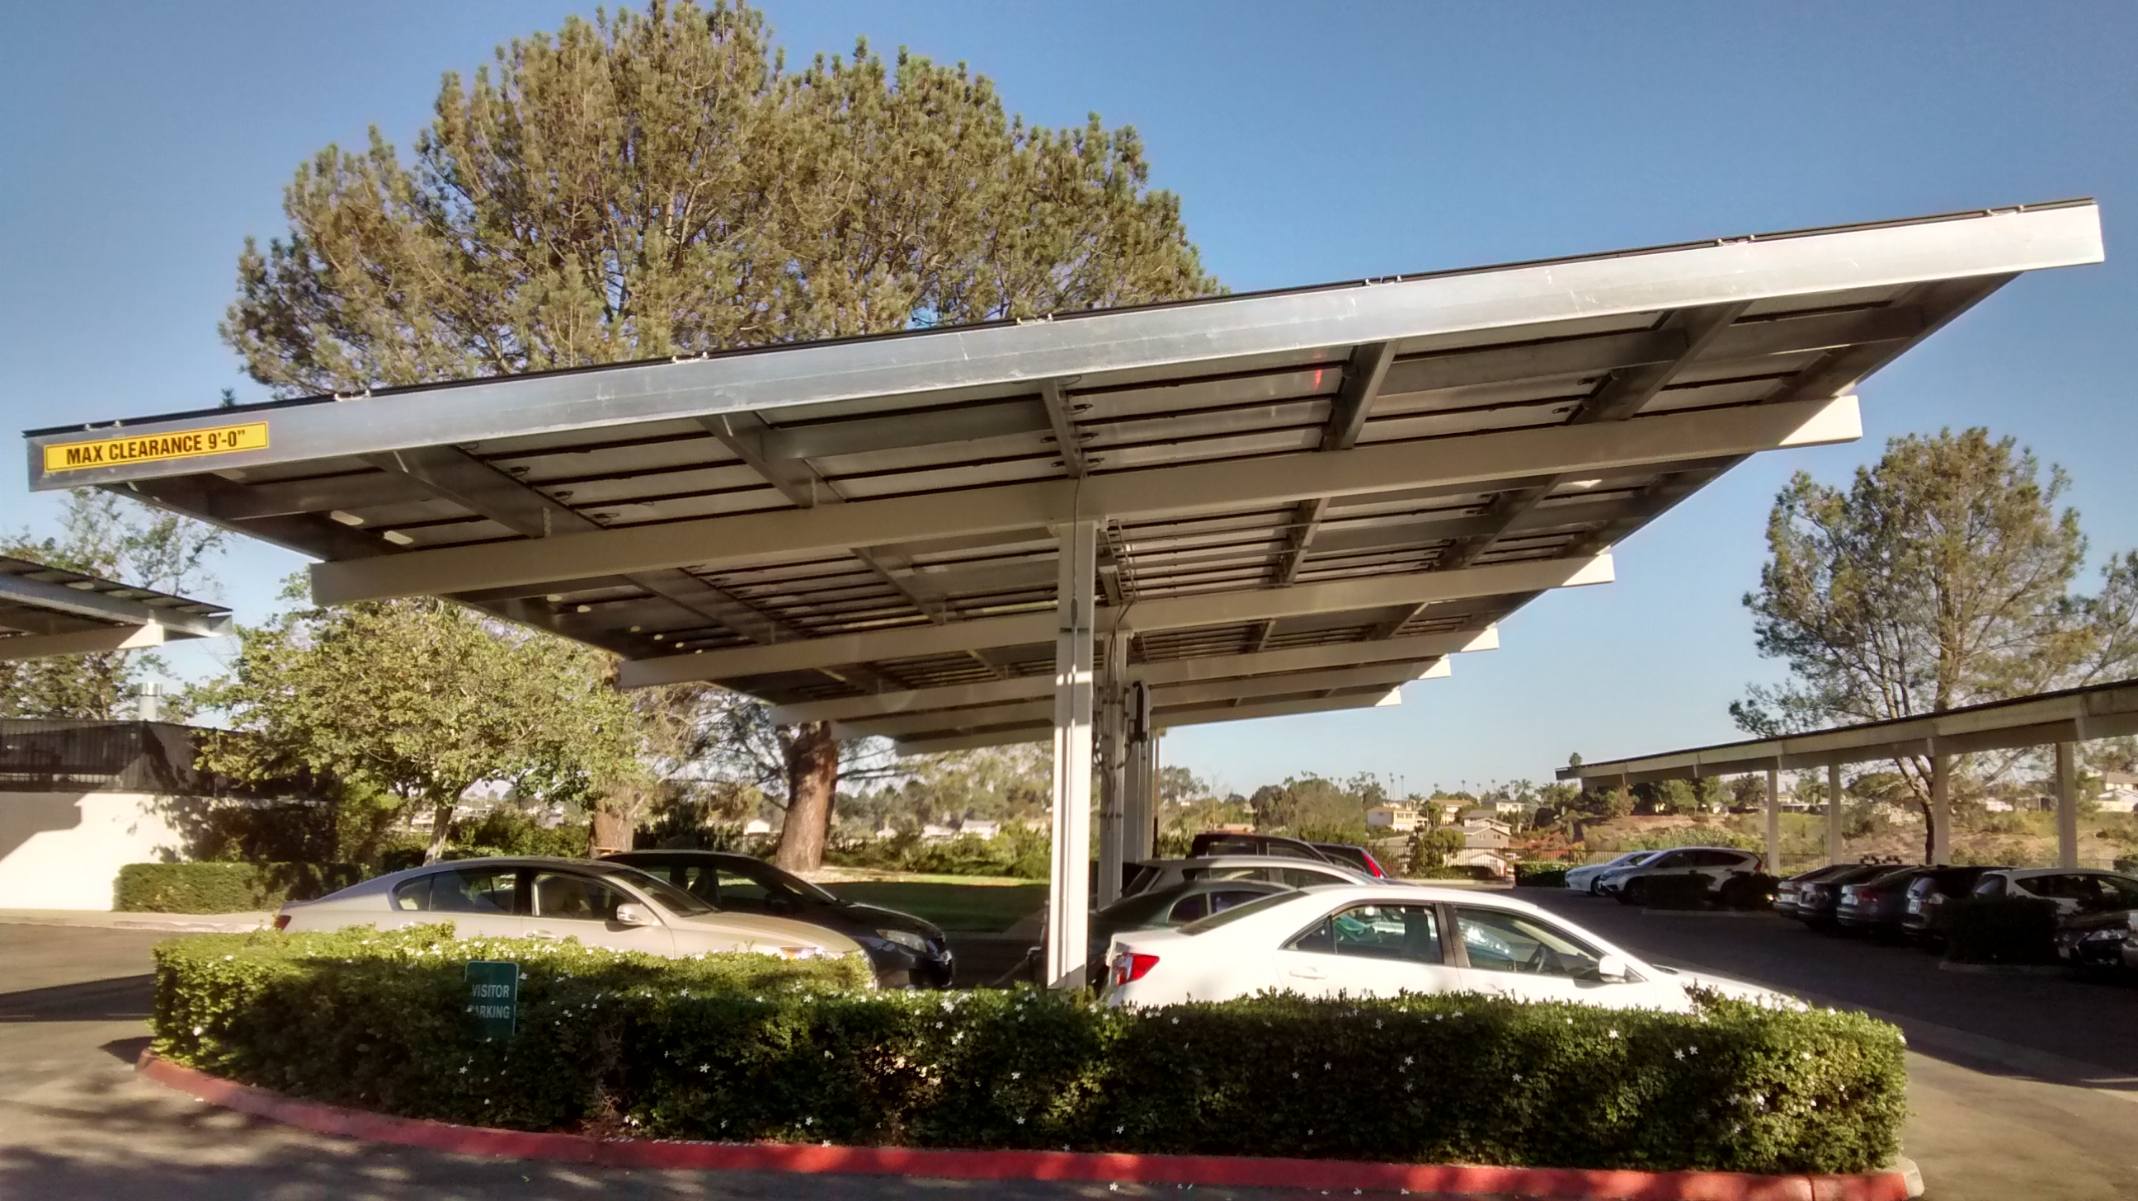
In DECEMBER 1997 ministers from industrialized nations adopted the Kyoto Protocol agreeing to set legally-binding reduction targets on greenhouse gases. Following additional intensive campaigning, the Kyoto Protocol is ratified by the European Union in March 2002 and by Russia in October 2004.
Solar panels
on the
parking lot
Carport, at
The Pastoral
Center, Dioc.
of San Diego.

Slide 9
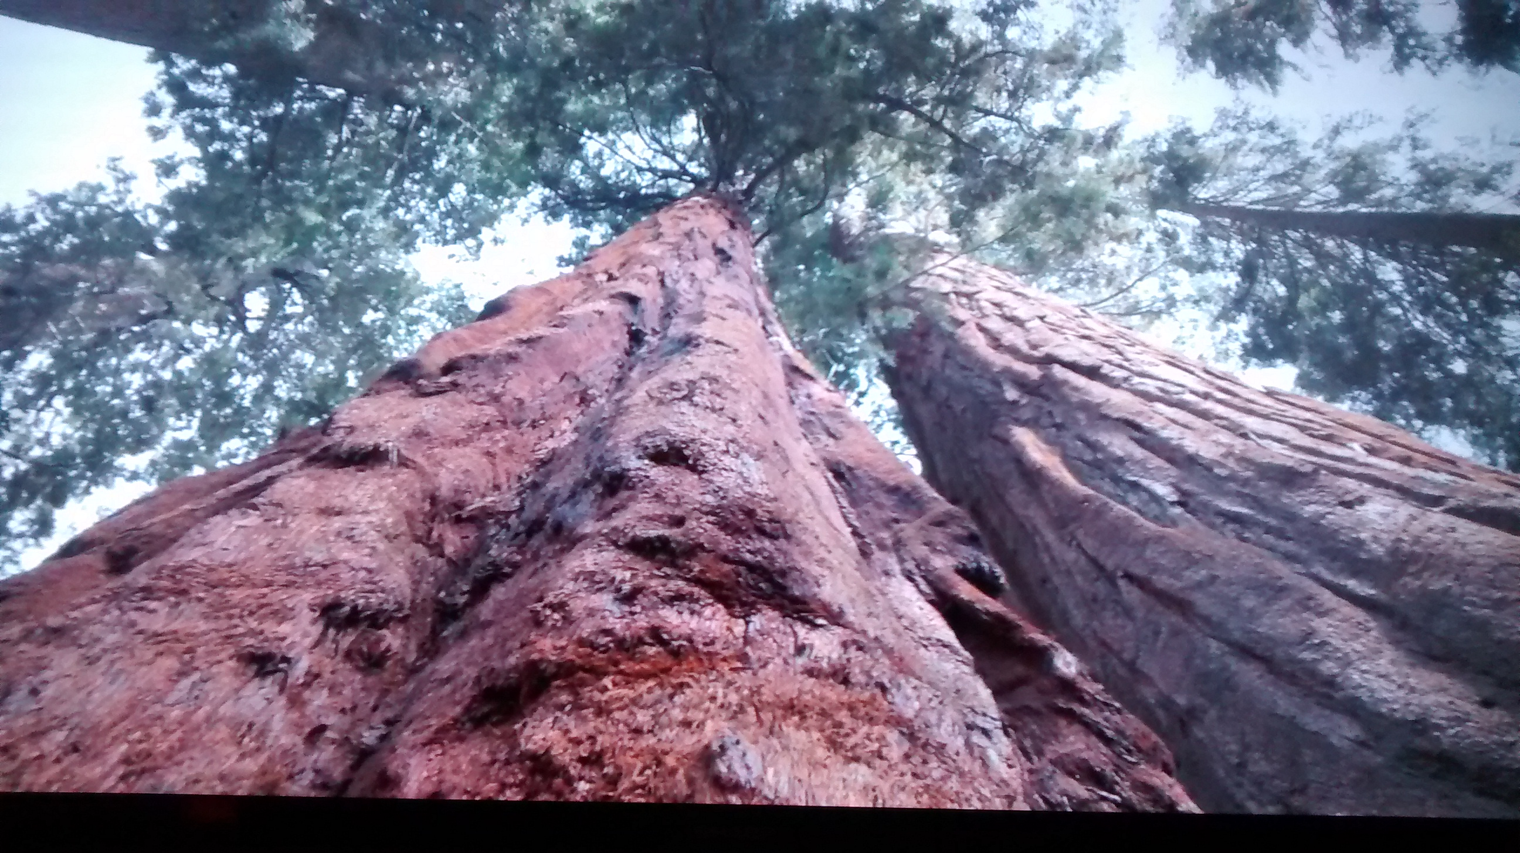
In DECEMBER 2000 following years of campaigning of the trade and investments of companies involved in logging the endangered Great Bear Rainforest, a historic conservation agreement is reached to conserve Canada’s remaining costal rainforest.

Slide 10
In MAY 2002 a major drive by Japan to re-introduce commercial whaling is defeated.
Sculpture
totally
made from
refuse
recovered
from the
oceans.

Slide 11
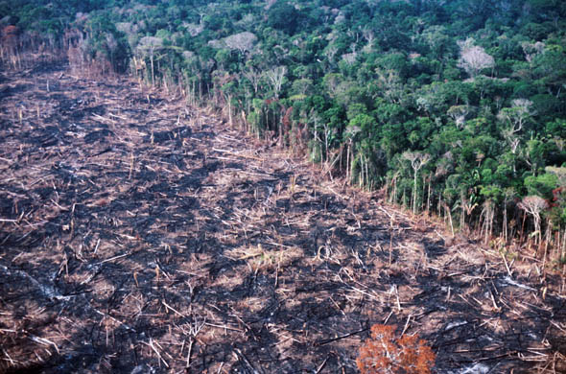
In AUGUST 2003 the Indigenous peoples of the Amazon celebrate the end of an 18-year campaign to mark their land as protected from logging. Greenpeace used GPS technology and a helicopter for a month to create an “eco-corridor” around 3.6 million hectares of land.
Result of
logging
in the
Amazon
Rainforest

Slide 12
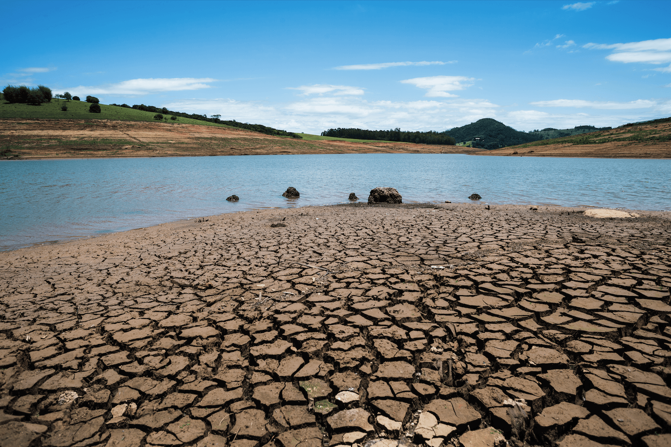
In FEBRUARY 2006 A 6.4 million hectare conservation area is created in Brazil, a great victory for the people of the Amazon battling land grabbers, cattle ranchers and loggers.
Result of
over
logging
and
destroying
native
plants.

Slide 13
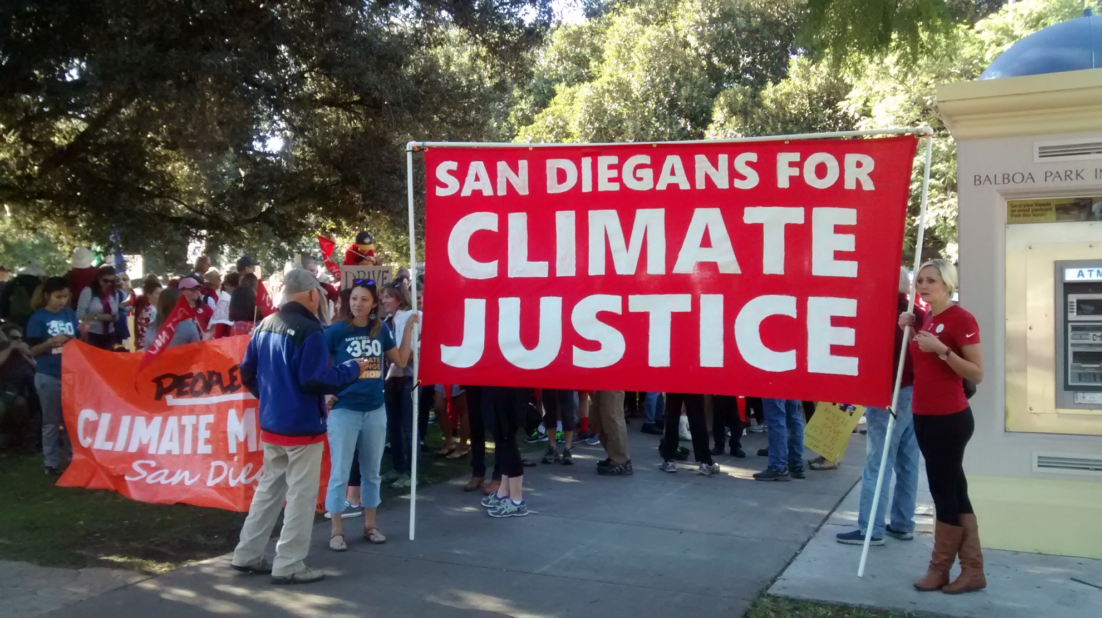
In MARCH 2009 the Great Bear Rainforest protection agreement went into force in Canada, capping one of the longest campaigns for protecting an area half the size of Switzerland from logging. The campaign was won with direct non-violent action on the ground, consumer pressure, stockholder actions, and thousands of online activists worldwide.
Climate
March
in Balboa
Park
2016

Slide 14
In JANUARY 2015 UN member states agree to form a historic international treaty to protect marine biodiversity in ocean areas extending beyond territorial waters.
Diocesan
banner in
the 2017
Climate
March in
San Diego

Slide 15
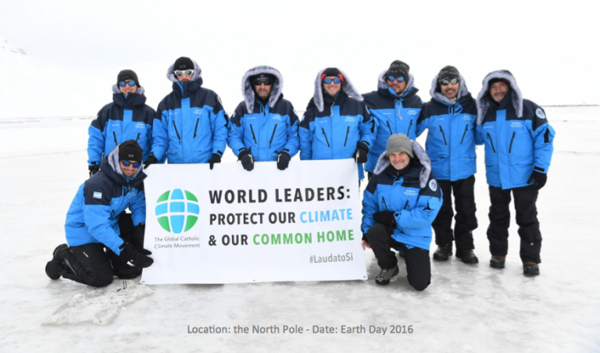
In SEPTEMBER 2015 Shell Oil Company abandoned Arctic drilling.

Slide 16
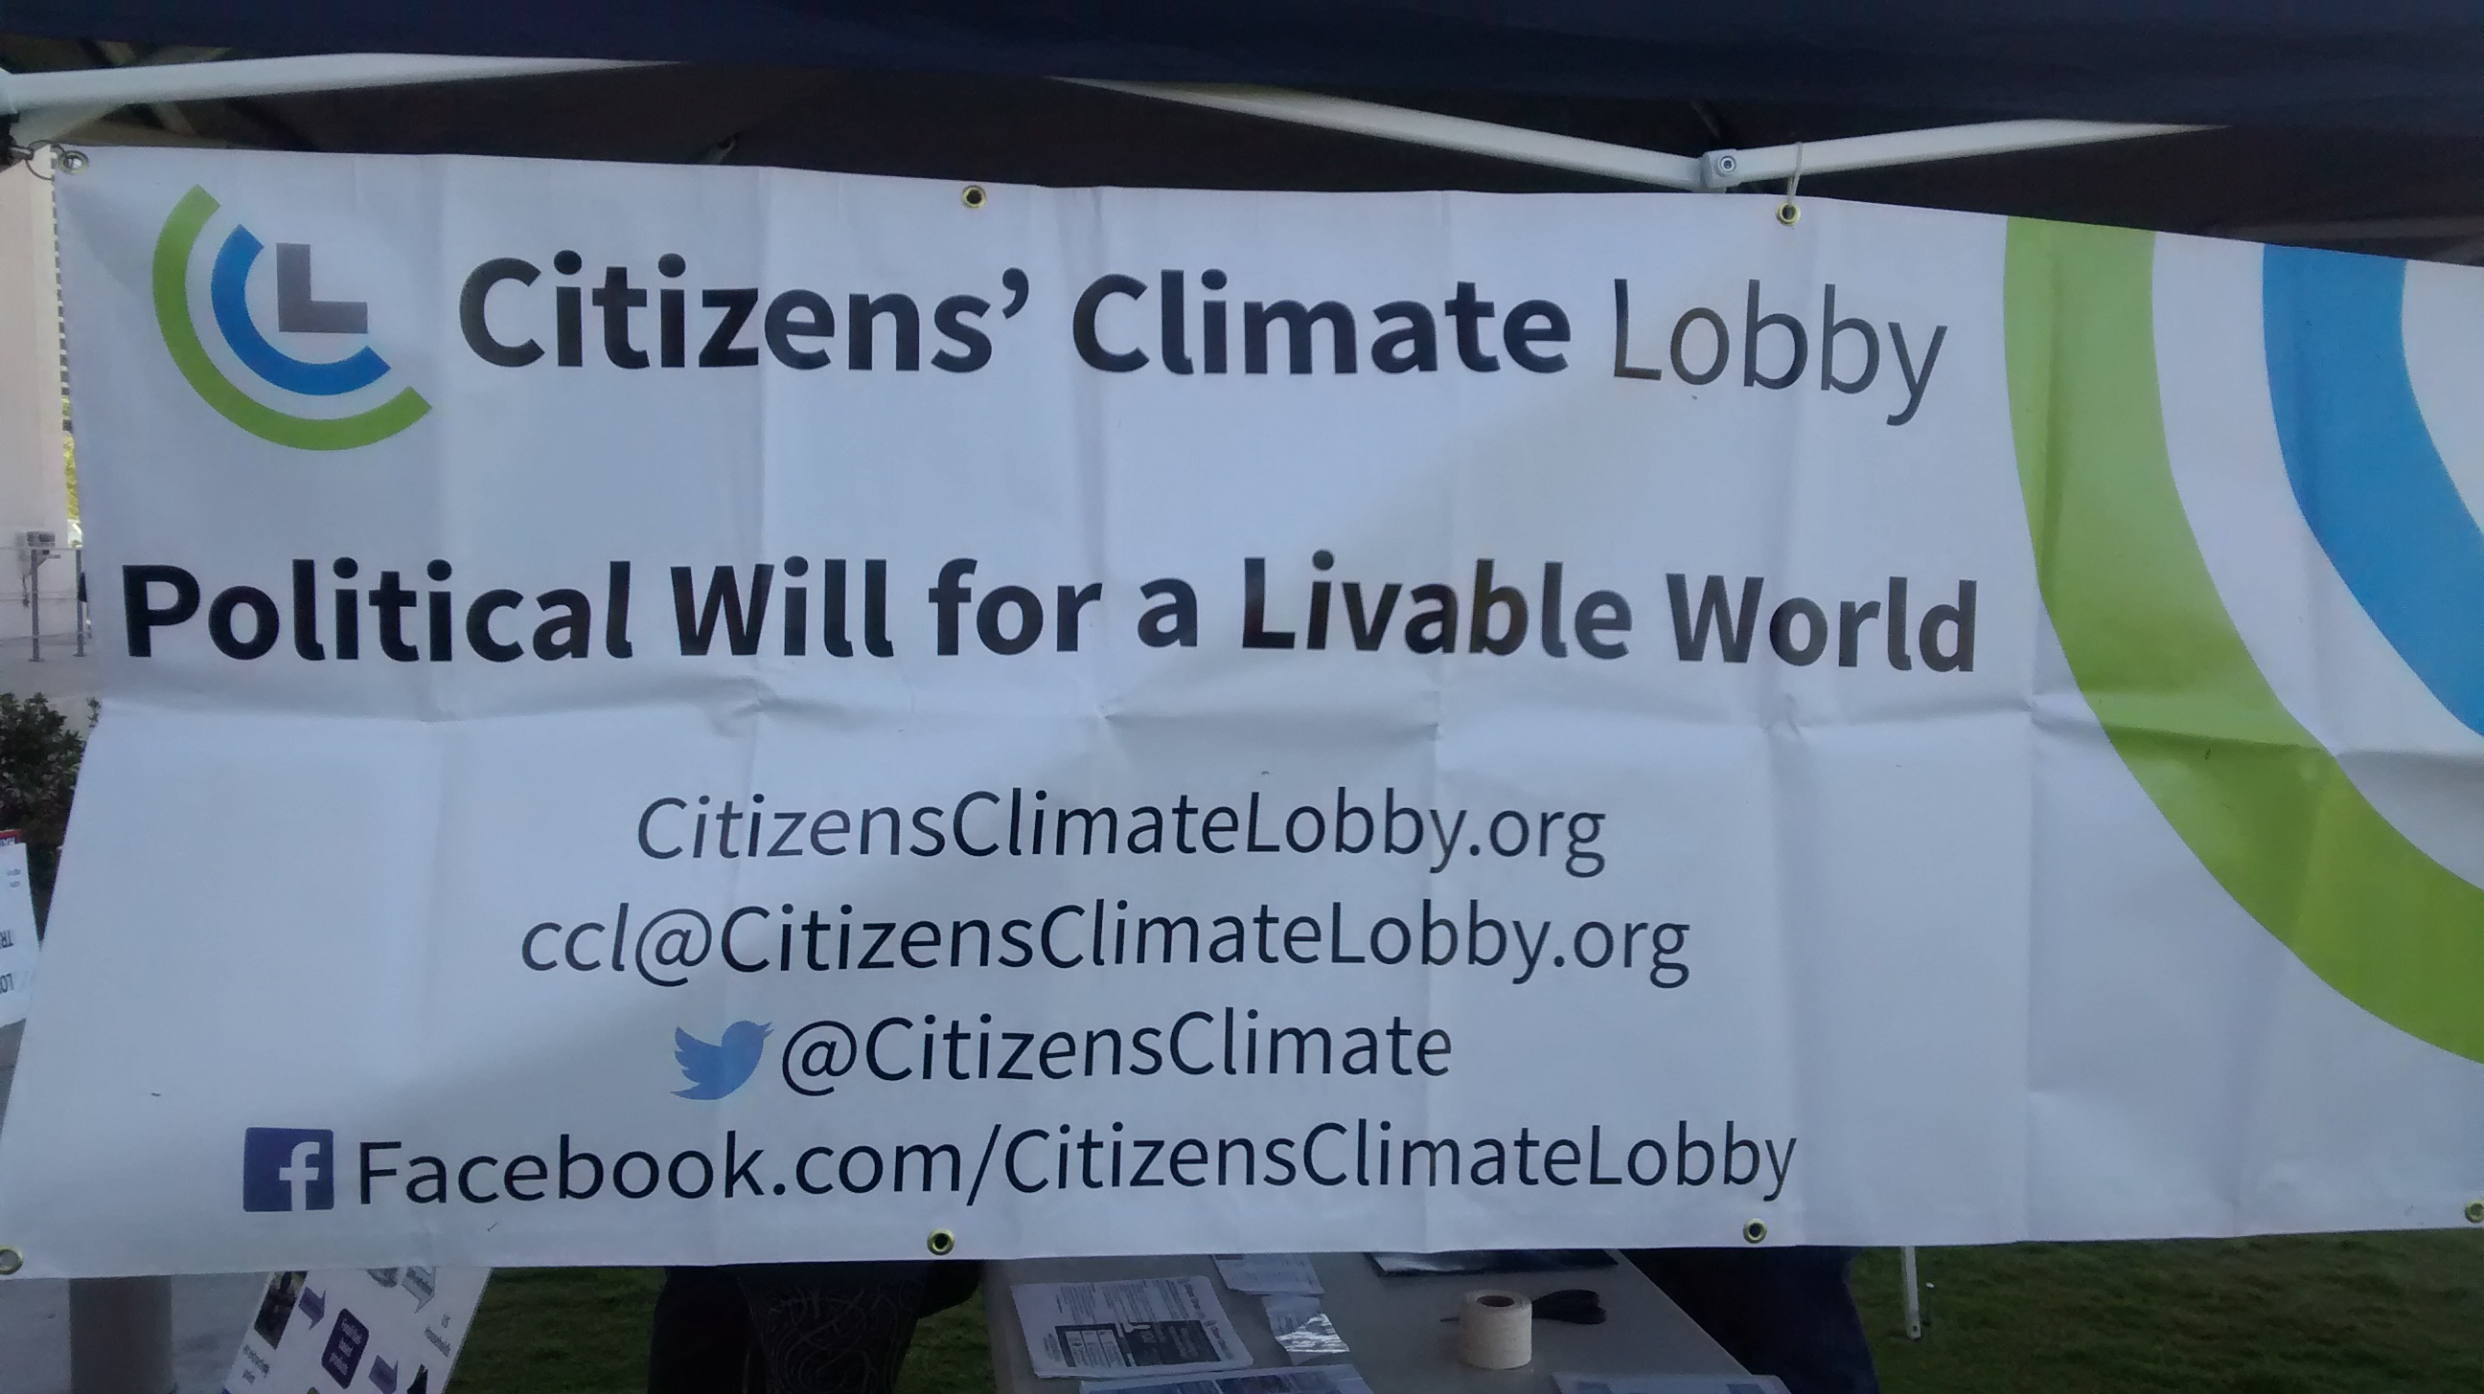
In OCTOBER 2016 the largest marine protected area in the world is created in the Ross Sea, off the coast of Antarctica. Millions of people around the world were mobilized to call on governments to make the Ross Sea a protected sanctuary;

Slide 17
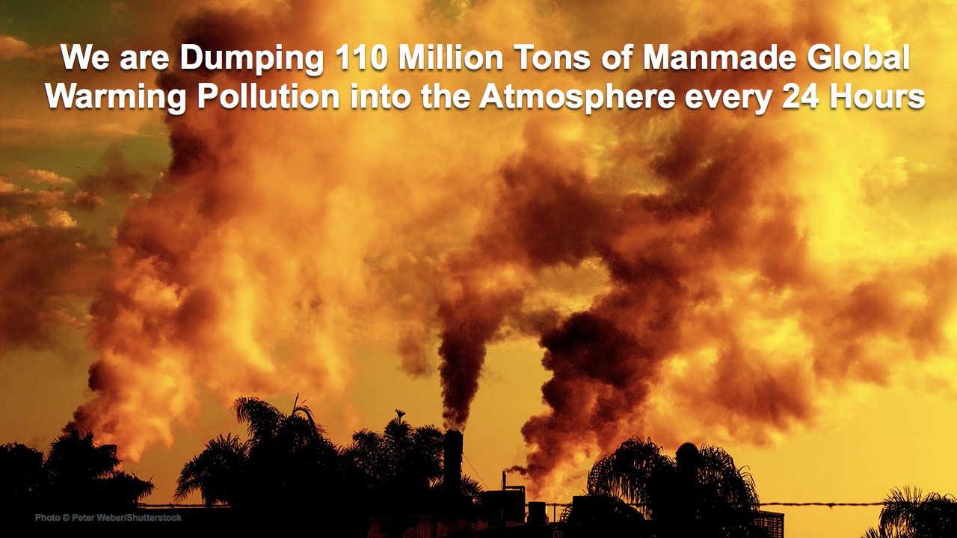
In JANUARY 2016 the Obama Administration announced a major overhaul of the federal coal program, which includes a moratorium on new leases and a comprehensive review that will look at carbon impacts, royalty rates, leasing practices, and more.

Slide 18
The content information for this power point was taken from a brochure entitled “RESIST” by “Greenpeace”. Further information can be obtained at greenpeace.org

